Slide 1

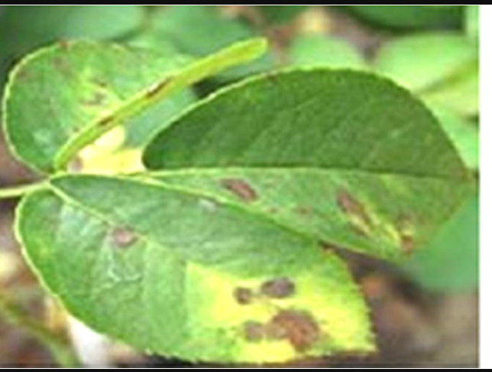
Leaf Disease Detection
ID no : 16CP024
16CP031

Slide 2
Problem Defination:
Prediction of Leaf Disease in early stage to end it from further spreading and reduce its effect

Slide 3
Need for detection:
Agricultural productivity
economy

Slide 4
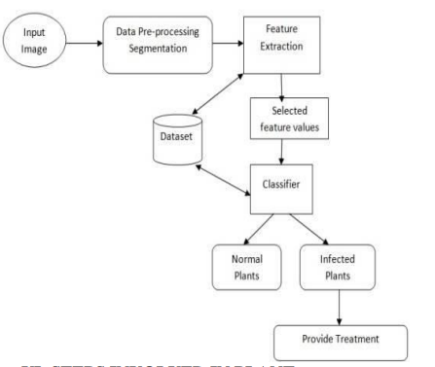
Methodology:

Slide 5
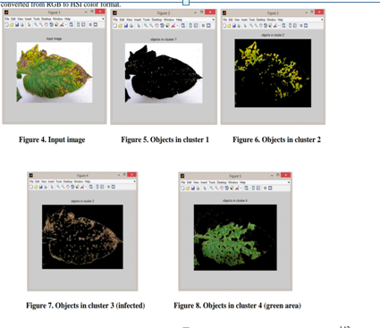

Slide 6
Applications:
Agriculture
Medicine

Slide 7
Thank you

